Slide 1
CS252 Database Management Systems
Jan – May 2020
IV Semester
* Use the slides for reference only. Refer the text book for details

Slide 2
Course Information
Syllabus and Lesson plan
Topics mentioned for classes 39 – 42 are optional and not part of the syllabus for ESA
Scheme of evaluation
ISA 1 = 20 (CBT, Max marks = 40)
ISA 2 = 20 (CBT, Max marks = 40)
Assignment = 20 (4 exercises = 10 + Quiz = 10)
Assignment
Reading assignment topics part of the syllabus for ISA and ESA
Submission deadlines and mode of submission

Slide 3
Basic definitions
Database:
A collection of related data.
Data:
Known facts that can be recorded and have an implicit meaning.
Mini-world:
Some part of the real world about which data is stored in a database. For example, student grades and transcripts at a university.
Database Management System (DBMS):
A software package/ system to facilitate the creation and maintenance of a computerized database.
Database System:
The DBMS software together with the data itself. Sometimes, the applications are also included.

Slide 4
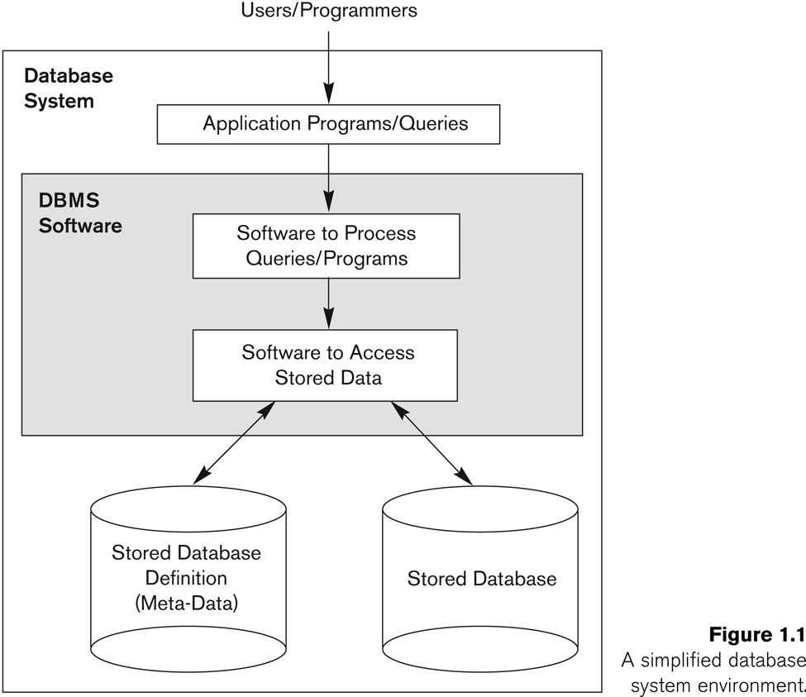
Database system environment

Slide 5
DBMS Functionality
Define a particular database in terms of its data types, structures, and constraints
Construct or Load the initial database contents on a secondary storage medium
Manipulating the database:
Retrieval: Querying, generating reports
Modification: Insertions, deletions and updates to its content
Accessing the database through Web applications
Processing and Sharing by a set of concurrent users and application programs – yet, keeping all data valid and consistent
Protection or Security measures to prevent unauthorized access
“Active” processing to take internal actions on data
Presentation and Visualization of data
Maintenance of the database and associated programs over the lifetime of the database application

Slide 6
Advantages of using a database
Controlling redundancy in data storage and in development and maintenance efforts.
Sharing of data among multiple users.
Restricting unauthorized access to data
Providing persistent storage for program Objects
E.g., Object-oriented DBMSs make program objects persistent
Providing Storage Structures and search techniques for efficient Query Processing
Providing backup and recovery

Slide 7
Advantages of using a database
Providing multiple interfaces to different classes of users.
Representing complex relationships among data.
Enforcing integrity constraints on the database.
Drawing inferences and actions from the stored data using deductive and active rules and triggers
Potential for enforcing standards
Reduced application development time
Flexibility to change data structures
Availability of current information
Economies of scale

Slide 8
History of database applications
Hierarchical and Network Models
Relational Model based Systems
Object-oriented and emerging applications
Data on the Web and E-commerce Applications
Special functionality is being added to DBMSs in the following areas:
Scientific Applications – Physics, Chemistry, Biology - Genetics
Earth and Atmospheric Sciences and Astronomy
XML (eXtensible Markup Language)
Image Storage and Management
Audio and Video Data Management
Data Warehousing and Data Mining
Spatial Data Management and Location Based Services
Time Series and Historical Data Management

